Slide 1
Memory Hierarchy (Ⅱ)

Slide 2
Outline
Storage trends
Locality
The memory hierarchy
Cache memories
Suggested Reading: 6.1, 6.2, 6.3, 6.4

Slide 3
Storage Trends
SRAM
Metric 1980 1985 1990 1995 2000 2005 2010 2010:1980
$/MB 19,200 2,900 320 256 100 75 60 320
access (ns) 300 150 35 15 3 2 1.5 200
DRAM
Metric 1980 1985 1990 1995 2000 2005 2010 2010:1980
$/MB 8,000 880 100 30 1 0.1 0.06 130,000
access (ns) 375 200 100 70 60 50 40 9
typical size (MB) 0.064 0.256 4 16 64 2,000 8,000 125,000
Disk
Metric 1980 1985 1990 1995 2000 2005 2010 2010:1980
$/MB 500 100 8 0.30 0.01 0.005 0.0003 1,600,000
access (ms) 87 75 28 10 8 4 3 29
typical size (MB) 1 10 160 1,000 20,000 160,000 1,500,000 1,500,000

Slide 4
CPU Clock Rates
Inflection point in computer history
when designers hit the “Power Wall”
1980 1990 1995 2000 2003 2005 2010 2010:1980
CPU 8080 386 Pentium P-III P-4 Core 2 Core i7 ---
Clock
rate (MHz) 1 20 150 600 3300 2000 2500 2500
Cycle
time (ns) 1000 50 6 1.6 0.3 0.50 0.4 2500
Cores 1 1 1 1 1 2 4 4
Effective
cycle 1000 50 6 1.6 0.3 0.25 0.1 10,000
time (ns)

Slide 5
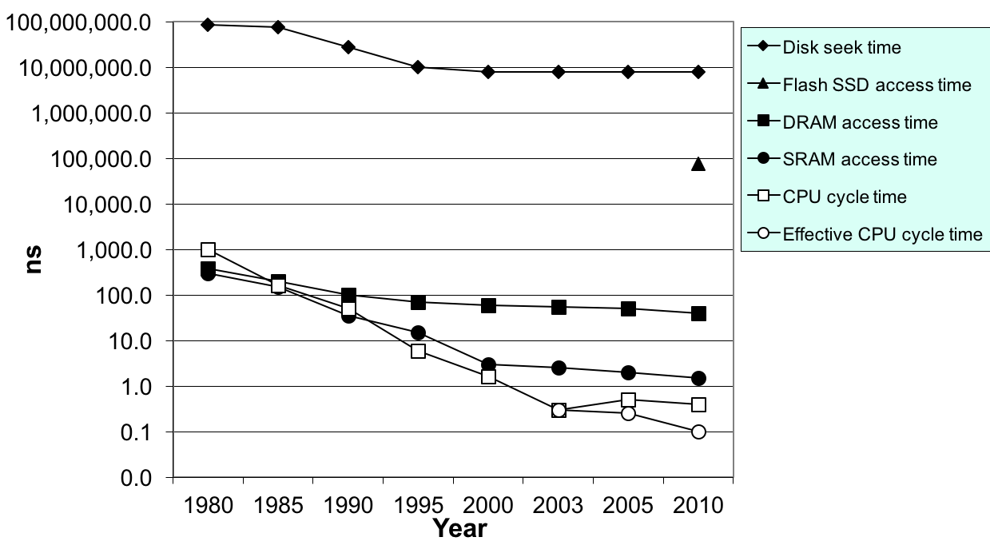
The CPU-Memory Gap
Disk
SSD
DRAM
CPU

Slide 6
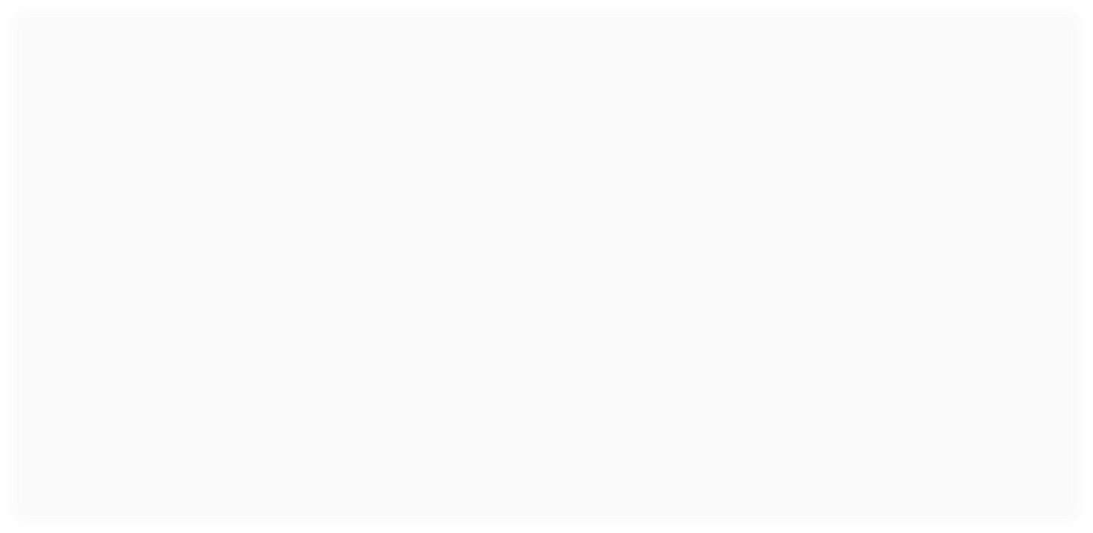
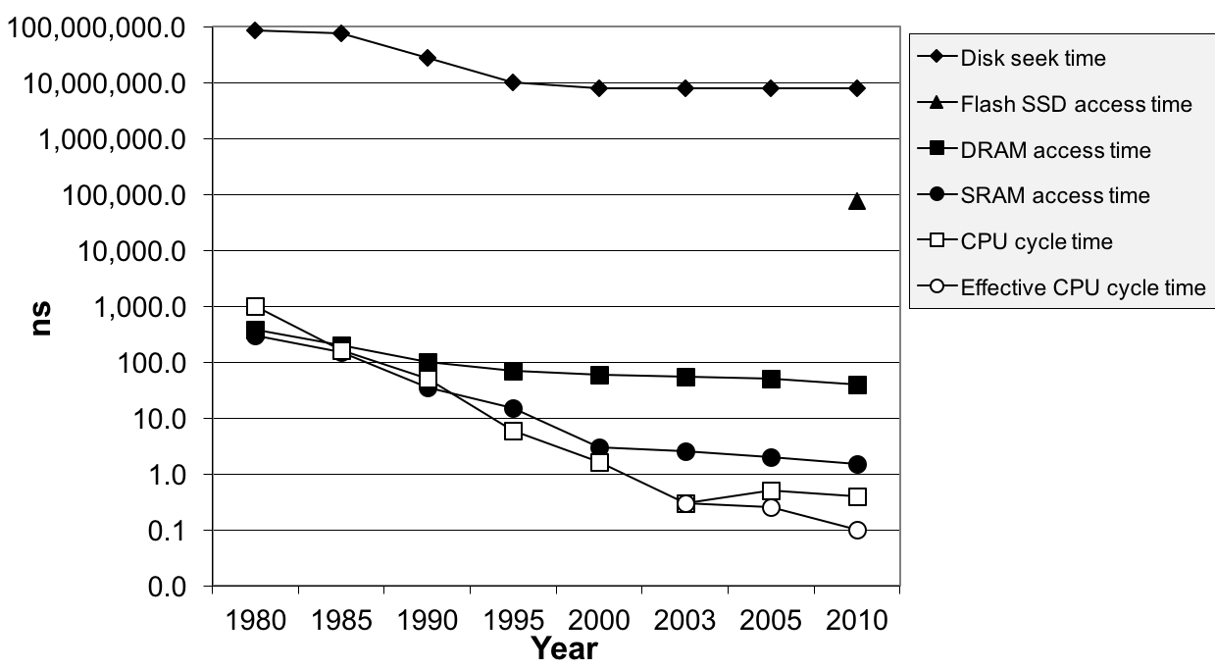
The CPU-Memory Gap
The gap widens between DRAM, disk, and CPU speeds.
Disk
The key to bridging this CPU-Memory gap is
a fundamental property of computer programs
known as locality
SSD
DRAM
CPU

Slide 7
Storage technologies and trends
Locality
The memory hierarchy
Cache memories

Slide 8
Locality
Principle of Locality: Programs tend to use data and instructions with addresses near or equal to those they have used recently
  Temporal locality
    Recently referenced items are likely
    to be referenced again in the near future
  Spatial locality
    Items with nearby addresses tend
    to be referenced close together in time

Slide 9
Locality
All levels of modern computer systems are designed to exploit locality
  Hardware
    Cache memory (to speed up main memory accesses)
  Operating systems
    Use main memory to speed up virtual address space accesses
    Use main memory to speed up disk file accesses
  Application programs
    Web browsers exploit temporal locality by caching recently referenced documents on a local disk

Slide 10
Locality
int sumvec(int v[N])
{
int i, sum = 0 ;
for (i = 0 ; i < N ; i++)
sum += v[i] ;
return sum ;
}
Address | 0 | 4 | 8 | 12 | 16 | 20 | 24 | 28
Contents | v₀ | v₁ | v₂ | v₃ | v₄ | v₅ | v₆ | v₇
Access order | 1 | 2 | 3 | 4 | 5 | 6 | 7 | 8

Slide 11
Locality
Locality in the example
  sum: temporal locality
  v: spatial locality
    Stride-1 reference pattern
Stride-k reference pattern
  Visiting every k-th element of a contiguous vector
  As the stride increases, the spatial locality decreases

Slide 12
Stride-1 reference pattern
int sumarrayrows(int a[M][N]) //M=2,N=3
{
int i, j, sum = 0 ;
for (i = 0 ; i < M ; i++)
for ( j = 0 ; j < N ; j++ )
sum += a[i][j] ;
return sum ;
}
Address | 0 | 4 | 8 | 12 | 16 | 20
Contents | a₀₀ | a₀₁ | a₀₂ | a₁₀ | a₁₁ | a₁₂
Access order | 1 | 2 | 3 | 4 | 5 | 6

Slide 13
Stride-N reference pattern
int sumarraycols(int a[M][N]) //M=2,N=3
{
int i, j, sum = 0 ;
for (j = 0 ; j < N ; j++)
for ( i = 0 ; i < M ; i++ )
sum += a[i][j] ;
return sum ;
}
Address | 0 | 4 | 8 | 12 | 16 | 20
Contents | a₀₀ | a₀₁ | a₀₂ | a₁₀ | a₁₁ | a₁₂
Access order | 1 | 3 | 5 | 2 | 4 | 6

Slide 14
Locality
Locality of the instruction fetch
  Spatial locality
    In most cases, programs are executed in sequential order
  Temporal locality
    Instructions in loops may be executed many times

Slide 15
Locality
sum = 0;
for (i = 0; i < n; i++)
sum += a[i];
return sum;
Data references
  Reference array a elements in succession Spatial locality
  Reference variable sum each iteration Temporal locality
Instruction references
  Reference instructions in sequence. Spatial locality
  Cycle through loop repeatedly Temporal locality

Slide 16
Storage technologies and trends
Locality
The memory hierarchy
Cache memories

Slide 17
Memory Hierarchy
Fundamental properties of storage technology and computer software
  Different storage technologies have widely different access times
  Faster technologies cost more per byte than slower ones and have less capacity
  The gap between CPU and main memory speed is widening
  Well-written programs tend to exhibit good locality

Slide 18
An example memory hierarchy
Smaller,
faster,
and
costlier
(per byte)
storage
devices
L0:
CPU registers hold words retrieved from cache memory.
registers
L1:
on-chip L1
cache (SRAM)
L1 cache holds cache lines retrieved from the L2 cache.
L2:
off-chip L2
cache (SRAM)
L2 cache holds cache lines retrieved from memory.
main memory
(DRAM)
Main memory holds disk
blocks retrieved from local
disks.
L3:
Larger,
slower,
and
cheaper
(per byte)
storage
devices
L4:
local secondary storage
(local disks)
Local disks hold files retrieved from disks on remote network servers.
L5:
remote secondary storage
(distributed file systems, Web servers)

Slide 19
Caches
Fundamental idea of a memory hierarchy:
  For each K, the faster, smaller device at level K serves as a cache for the larger, slower device at level K+1.
Why do memory hierarchies work?
  Because of locality, programs tend to access the data at
  level k more often than they access the data at level k+1.
  Thus, the storage at level k+1 can be slower, and thus larger and cheaper per bit.
Big Idea: The memory hierarchy creates a large pool of storage that costs as much as the cheap storage near the bottom, but that serves data to programs at the rate of the fast storage near the top.

Slide 20
General Cache Concepts
Smaller, faster, more expensive
memory caches a subset of
the blocks
Cache
8
4
9
14
10
3
Data is copied in block-sized transfer units
4
10
Larger, slower, cheaper memory
viewed as partitioned into “blocks”
0
1
2
3
4
4
5
6
7
8
9
10
10
11
12
13
14
15

Slide 21
General Cache Concepts: Hit
Request: 14
Data in block b is needed
Cache
Block b is in cache:
Hit!
8
9
14
3
14
0
1
2
3
4
5
6
7
8
9
10
11
12
13
14
15

Slide 22
General Cache Concepts: Miss
Request: 12
Data in block b is needed
Cache
Block b is not in cache:
Miss!
8
9
14
3
12
Block b is fetched from
memory
12
Request: 12
Block b is stored in cache
Placement policy:
determines where b goes
Replacement policy:
determines which block
gets evicted (victim)
0
1
2
3
4
5
6
7
8
9
10
11
12
12
13
14
15

Slide 23
Types of Cache Misses
Cold (compulsory) miss
  Cold misses occur because the cache is empty.
Capacity miss
  Occurs when the set of active cache blocks (working set) is larger than the cache.

Slide 24
Types of Cache Misses
Conflict miss
  Most caches limit blocks at level k+1 to a small subset (sometimes a singleton) of the block positions at level k.
    e.g. Block i at level k+1 must be placed in block (i mod 4) at level k.
  Conflict misses occur when the level k cache is large enough, but multiple data objects all map to the same level k block.
    e.g. Referencing blocks 0, 8, 0, 8, 0, 8, ... would miss every time.

Slide 25
Cache Memory
History
  At very beginning, 3 levels
    Registers, main memory, disk storage
  10 years later, 4 levels
    Register, SRAM cache, main DRAM memory, disk storage
  Modern processor, 5~6 levels
    Registers, SRAM L1, L2(,L3) cache, main DRAM memory, disk storage
  Cache memories
    small, fast SRAM-based memories
    managed by hardware automatically
    can be on-chip, on-die, off-chip

Slide 26
Examples of Caching in the Hierarchy
Cache Type
What is Cached?
Where is it Cached?
Latency (cycles)
Managed By
Registers
4-8 bytes words
CPU core
0
Compiler
TLB
Address translations
On-Chip TLB
0
Hardware
L1 cache
64-bytes block
On-Chip L1
1
Hardware
L2 cache
64-bytes block
On/Off-Chip L2
10
Hardware
Virtual Memory
4-KB page
Main memory
100
Hardware + OS
Buffer cache
Parts of files
Main memory
100
OS
Disk cache
Disk sectors
Disk controller
100,000
Disk firmware
Network buffer cache
Parts of files
Local disk
10,000,000
AFS/NFS client
Browser cache
Web pages
Local disk
10,000,000
Web browser
Web cache
Web pages
Remote server disks
1,000,000,000
Web proxy server

Slide 27
Storage technologies and trends
Locality
The memory hierarchy
Cache memories

Slide 28
Cache Memory
CPU looks first for data in L1, then in L2, then in main memory
  Hold frequently accessed blocks of main memory in caches
CPU chip
register file
ALU
Cache
memory
system bus
memory bus
main
memory
bus interface
I/O
bridge

Slide 29
Inserting an L1 cache between the CPU and main memory
The tiny, very fast CPU register file
has room for four 4-byte words.
The transfer unit between
the CPU register file and
the cache is a 4-byte block.
line 0
The small fast L1 cache has room
for two 8-word blocks.
line 1
The transfer unit between
the cache and main
memory is a 8-word block
(32 bytes).
block 10
a b c d
...
The big slow main memory
has room for many 8-word
blocks.
block 21
p q r s
...
block 30
w x y z
...

Slide 30
Generic Cache Memory Organization
Cache is an array
of sets.
Each set contains
one or more lines.
Each line holds a
block of data.
1 valid bit
per line
t tag bits
per line
B = 2^{b} bytes
per cache block
valid
tag
0
1
• • •
B–1
E lines
per set
set 0:
• • •
valid
tag
0
1
• • •
B–1
valid
tag
0
1
• • •
B–1
set 1:
• • •
S = 2^{s} sets
valid
tag
0
1
• • •
B–1
• • •
valid
tag
0
1
• • •
B–1
set S-1:
• • •
valid
tag
0
1
• • •
B–1

Slide 31
Cache Memory
Fundamental parameters
Parameters | Descriptions
S = 2^{s} E B=2^{b} m=log₂(M) | Number of sets Number of lines per set Block size(bytes) Number of physical(main memory) address bits

Slide 32
Cache Memory
Derived quantities
Parameters | Descriptions
M=2^{m} s=log2(S) b=log2(B) t=m-(s+b) C=B×E×S | Maximum number of unique memory address Number of set index bits Number of block offset bits Number of tag bits Cache size (bytes) not including overhead such as the valid and tag bits

Slide 33
Memory Accessing
For a memory accessing instruction
  movl A %eax
Access cache by A directly
If cache hit
  get the value from the cache
Otherwise,
  cache miss handling
  get the value

Slide 34
Addressing caches
Physical Address A:
m-1
0
Split into 3 parts:
t bits
s bits
b bits
m-1
0
<tag>
<set index>
<block offset>

Slide 35
Direct-mapped cache
Simplest kind of cache
Characterized by exactly one line per set.
p633
set 0:
valid
tag
cache block
E=1 lines per set
set 1:
valid
tag
cache block
• • •
set S-1:
valid
tag
cache block

Slide 36
Accessing Direct-Mapped Caches
Three steps
  Set selection
  Line matching
  Word extraction

Slide 37
Set selection
Use the set index bits to determine the set of interest
set 0:
valid
tag
cache block
selected set
set 1:
valid
tag
cache block
• • •
t bits
s bits
b bits
set S-1:
valid
tag
cache block
0 0 0 0 1
m-1
0
tag
set
index
block
offset

Slide 38
Line matching
Find a valid line in the selected set with a matching tag
=1?
(1) The valid bit must be set
0
1
2
3
4
5
6
7
selected set (i):
1
0110
(2) The tag bits in the cache line must match the tag bits in the address
= ?
t bits
s bits
b bits
0110
i
m-1
0
tag
set index
block offset

Slide 39
Word Extraction
0
1
2
3
4
5
6
7
selected set (i):
1
0110
w₀
w₁
w₂
w₃
block offset selects
starting byte
t bits
s bits
b bits
0110
i
100
m-1
0
tag
set index
block offset

Slide 40
Simple Memory System Cache
Cache
  16 lines
  4-byte line size
  Direct mapped
Tag
Index
Offset
11
10
9
8
7
6
5
4
3
2
1
0

Slide 41
Simple Memory System Cache
Idx | Tag | Valid | B0 | B1 | B2 | B3
0 | 19 | 1 | 99 | 11 | 23 | 11
1 | 15 | 0 | – | – | – | –
2 | 1B | 1 | 00 | 02 | 04 | 08
3 | 36 | 0 | – | – | – | –
4 | 32 | 1 | 43 | 6D | 8F | 09
5 | 0D | 1 | 36 | 72 | F0 | 1D
6 | 31 | 0 | – | – | – | –
7 | 16 | 1 | 11 | C2 | DF | 03

Slide 42
Simple Memory System Cache
Idx | Tag | Valid | B0 | B1 | B2 | B3
8 | 24 | 1 | 3A | 00 | 51 | 89
9 | 2D | 0 | – | – | – | –
A | 2D | 1 | 93 | 15 | DA | 3B
B | 0B | 0 | – | – | – | –
C | 12 | 0 | – | – | – | –
D | 16 | 1 | 04 | 96 | 34 | 15
E | 13 | 1 | 83 | 77 | 1B | D3
F | 14 | 0 | – | – | – | –

Slide 43
Address Translation Example
Address: 0x354
Tag
Index
Offset
11
10
9
8
7
6
5
4
3
2
1
0
0
0
1
1
0
1
0
1
0
1
0
0
  Offset: 0x0 Index: 0x05 Tag: 0x0D
  Hit? Yes Byte: 0x36

Slide 44
Line Replacement on Misses
Check the cache line of the set indicated by the set index bits
  If the cache line valid, it must be evicted
Retrieve the requested block from the next level
  How to get the block ?
Current line is replaced by the newly fetched line

Slide 45

Check the cache line
=1?
If valid bit is set, evict the line
0
1
2
3
4
5
6
7
selected set (i):
1
Tag

Slide 46
Get the Address of the Starting Byte
Consider memory address looks like the following
Clear the last bits and get the address A
m-1
0
xxx… … … xxx
<tag>
<set index>
<block offset>
m-1
0
000 … … …000
<tag>
<set index>
<block offset>

Slide 47
Read the Block from the Memory
Put A on the Bus (A is A’000)
CPU chip
register file
ALU
Cache
memory
system bus
memory bus
main memory
0
A
bus interface
I/O
bridge
x
A’

Slide 48
Read the Block from the Memory
Main memory reads A’ from the memory bus, retrieves 8 bytes x, and places it on the bus
CPU chip
register file
ALU
Cache
memory
system bus
memory bus
main memory
0
X
bus interface
I/O
bridge
x
A’

Slide 49

Read the Block from the Memory
CPU reads x from the bus and copies it into the cache line
CPU chip
register file
ALU
Cache
memory
system bus
memory bus
main memory
0
bus interface
I/O
bridge
x
A’

Slide 50

Read the Block from the Memory
Increase A’ by 1, and copy Y in A’+1 into the cache line.
CPU chip
register file
ALU
Cache
memory
system bus
memory bus
main memory
0
bus interface
I/O
bridge
Y
A’+1

Slide 51

Read the Block from the Memory
Repeat several times (4 or 8 )
CPU chip
register file
ALU
Cache
memory
system bus
memory bus
main memory
0
bus interface
I/O
bridge
W
A’+3

Slide 52
Cache line, set and block
Block
  A fixed-sized packet of information
    Moves back and forth between a cache and main memory (or a lower-level cache)
Line
  A container in a cache that stores
    A block, the valid bit, the tag bits
    Other information
Set
  A collection of one or more lines

Slide 53
Direct-mapped cache simulation
s=2
Example
M=16 byte addresses
B=2 bytes/block, S=4 sets, E=1 entry/set
t=1
b=1
x
xx
x
Address trace (reads):
0 [0000] 1 [0001] 13 [1101] 8 [1000] 0 [0000]
set
v
tag
data
0
0
1
0
2
0
3
0

Slide 54
Direct-mapped cache simulation
s=2
Example
M=16 byte addresses
B=2 bytes/block, S=4 sets, E=1 entry/set
t=1
b=1
x
xx
x
Address trace (reads):
0 [0000] 1 [0001] 13 [1101] 8 [1000] 0 [0000]
miss
(1)
0 [0000] (miss)
set
v
tag
data
0
1
0
m[0]m[1]
1
0
2
0
3
0

Slide 55
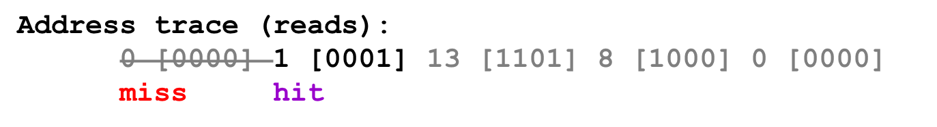
Direct-mapped cache simulation
s=2
Example
M=16 byte addresses
B=2 bytes/block, S=4 sets, E=1 entry/set
t=1
b=1
x
xx
x
(2)
1 [0001] (hit)
set
v
tag
data
0
1
0
m[0]m[1]
1
0
2
0
3
0

Slide 56
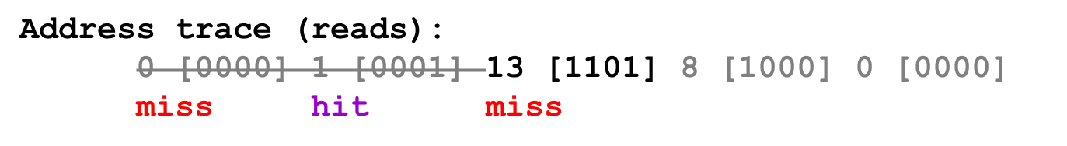
Direct-mapped cache simulation
s=2
Example
M=16 byte addresses
B=2 bytes/block, S=4 sets, E=1 entry/set
t=1
b=1
x
xx
x
(3)
13 [1101] (miss)
set
v
tag
data
0
1
0
m[0]m[1]
1
0
2
1
1
m[12]m[13]
3
0

Slide 57
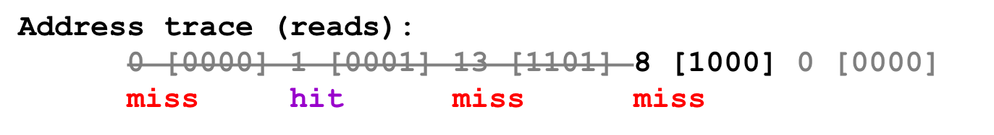
Direct-mapped cache simulation
s=2
Example
M=16 byte addresses
B=2 bytes/block, S=4 sets, E=1 entry/set
t=1
b=1
x
xx
x
(4)
8 [1000] (miss)
set
v
tag
data
0
1
1
m[8]m[9]
1
0
2
1
1
m[12]m[13]
3
0

Slide 58
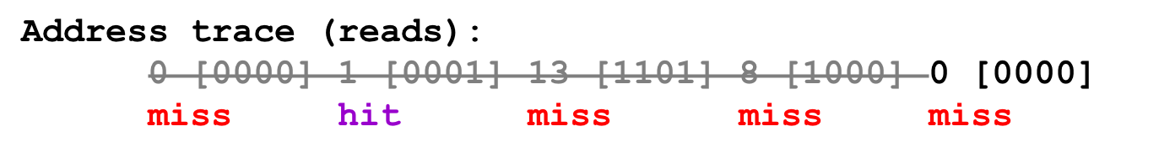
Direct-mapped cache simulation
s=2
Example
M=16 byte addresses
B=2 bytes/block, S=4 sets, E=1 entry/set
t=1
b=1
x
xx
x
(5)
0 [0000] (miss)
set
v
tag
data
0
1
0
m[0]m[1]
1
0
2
1
1
m[12]m[13]
3
0

Slide 59
Direct-mapped cache simulation
s=2
Example
M=16 byte addresses
B=2 bytes/block, S=4 sets, E=1 entry/set
t=1
b=1
x
xx
x
Address trace (reads):
0 [0000] 1 [0001] 13 [1101] 8 [1000] 0 [0000]
miss hit miss miss miss
(5)
0 [0000] (miss)
Thrashing!
set
v
tag
data
0
1
0
m[0]m[1]
1
0
2
1
1
m[12]m[13]
3
0

Slide 60
Conflict Misses in Direct-Mapped Caches
1 float dotprod(float x[8], float y[8])
2 {
3 float sum = 0.0;
4 int i;
5
6 for (i = 0; i < 8; i++)
7 sum += x[i] * y[i];
8 return sum;
9 }

Slide 61
Conflict Misses in Direct-Mapped Caches
Assumption for x and y
  x is loaded into the 32 bytes of contiguous memory starting at address 0
  y starts immediately after x at address 32
Assumption for the cache
  A block is 16 bytes
    big enough to hold four floats
  The cache consists of two sets
    A total cache size of 32 bytes

Slide 62
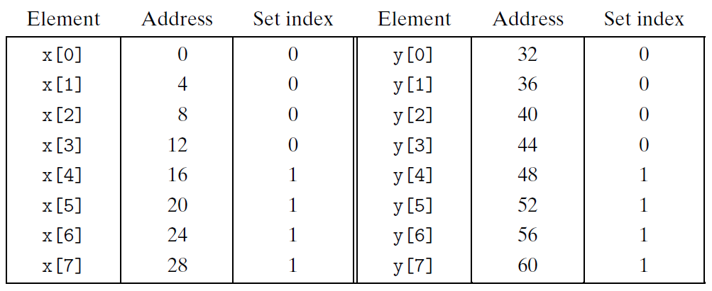
Conflict Misses in Direct-Mapped Caches
Trashing
  Read x[0] will load x[0] ~ x[3] into the cache
  Read y[0] will overload the cache line by y[0] ~ y[3]

Slide 63
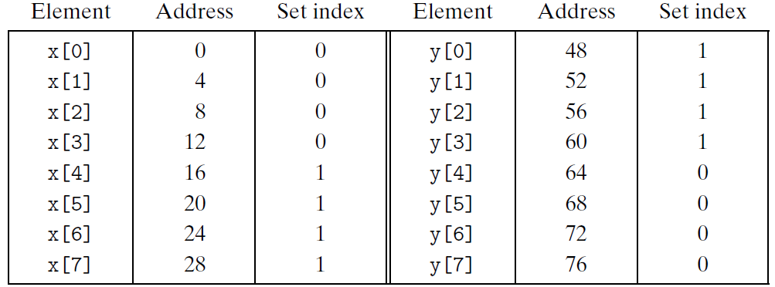
Conflict Misses in Direct-Mapped Caches
Padding can avoid thrashing
  Claim x[12] instead of x[8]

Slide 64
Direct-mapped cache simulation
 | Address bits
Address (decimal) | Tag bits (t=1) | Index bits (s=2) | Offset bits (b=1) | Set number (decimal)
0 1 2 3 4 5 6 7 8 9 10 11 12 13 14 15 | 0 0 0 0 0 0 0 0 1 1 1 1 1 1 1 1 | 00 00 01 01 10 10 11 11 00 00 01 01 10 10 11 11 | 0 1 0 1 0 1 0 1 0 1 0 1 0 1 0 1 | 0 0 1 1 2 2 3 3 0 0 1 1 2 2 3 3

Slide 65
Direct-mapped cache simulation
 | Address bits
Address (decimal) | Index bits (s=2) | Tag bits (t=1) | Offset bits (b=1) | Set number (decimal)
0 1 2 3 4 5 6 7 8 9 10 11 12 13 14 15 | 00 00 00 00 01 01 01 01 10 10 10 10 11 11 11 11 | 0 0 1 1 0 0 1 1 0 0 1 1 0 0 1 1 | 0 1 0 1 0 1 0 1 0 1 0 1 0 1 0 1 | 0 0 0 0 1 1 1 1 2 2 2 2 3 3 3 3

Slide 66
Why use middle bits as index?
High-Order
Bit Indexing
Middle-Order
Bit Indexing
4-line Cache
00
0000
0000
01
0001
0001
10
0010
0010
11
0011
0011
0100
0100
0101
0101
0110
0110
0111
0111
1000
1000
1001
1001
1010
1010
1011
1011
1100
1100
1101
1101
1110
1110
1111
1111

Slide 67
Why use middle bits as index?
High-Order Bit Indexing
  Adjacent memory lines would map to same cache entry
  Poor use of spatial locality
Middle-Order Bit Indexing
  Consecutive memory lines map to different cache lines
  Can hold C-byte region of address space in cache at one time

